Slide 1
The Spy in the Sandbox – Practical Cache Attacks in JavaScript
Proceedings of the 22nd ACM SIGSAC Conference on Computer and Communications Security, 2015
Yossef Oren, Vasileios P. Kemerlis, Simha Sethumadhavan and Angelos D. Keromytis
Computer Science Department, Columbia University

Slide 2
Outline
Introduction
Background
Attack Methodology
Creating an Eviction Set
Identifying Interesting Regions in the Cache
Cache-Based Covert Channel
User Behavior Tracking
Conclusion

Slide 3
Introduction
Side-channel analysis is a powerful class of cryptanalytic attack. It lets attackers extract secret information hidden inside a secure device by analyzing the physical signals as it performs a secure computation.
A particular kind of side-channel attack which is relevant to personal computers is the cache attack, which exploits the use of cache memory as a shared resource between different processes or users.

Slide 4
Introduction
While the potency of side-channel attacks is established without question, their application to practical systems is relatively limited:
With the exception of network-based timing attacks, most side-channel attacks require that the attacker be in close proximity to the victim.
Cache attacks typically assume that the attacker is capable of executing binaries code on the victim’s machine.

Slide 5
Introduction
In this report we challenge this limiting security assumption by presenting a successful cache attack which the victim merely has to access a website owned by the attacker.
We chose to focus our attacks not on cryptographic key recovery but rather on tracking user behavior.
This is the first side-channel attack which can scale effortlessly into millions of targets.

Slide 6
Introduction
For our attacks we assume:
The victim is using a personal computer powered by a late-model Intel CPU.
The user is accessing the web through a browser with comprehensive HTML5 support.
The victim is coerced to view a webpage containing an controlled element such as an advertisement.

Slide 7
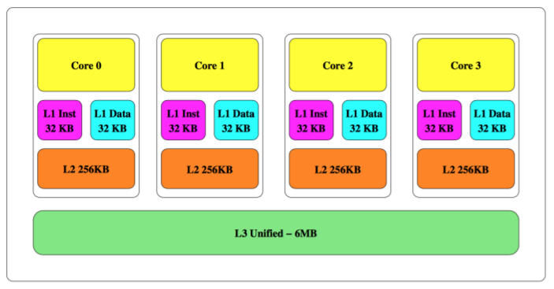
Background - Architecture of Modern Intel CPUs
The cache memory is typically arranged in a cache hierarchy, with a series of progressively larger and slower memory elements being placed in levels between the CPU and the RAM.
The Intel Ivy Bridge Cache Architecture

Slide 8
Background - Architecture of Modern Intel CPUs
If the CPU requires an element which is not currently in the cache, known as cache miss, then one of the elements currently residing in the cache must be evicted to make room for this new element.
The Intel cache micro-architecture is inclusive – all elements in the L1 cache must also exist in the L2 and L3 caches. Conversely, if a memory element is evicted from the L3 cache, it is also immediately evicted from the L2 and L1 cache.

Slide 9
Background - Architecture of Modern Intel CPUs
This report focusses on the L3 cache, the last-level cache(LLC).
The LLC is divided into cache sets, each covering a fixed subset of the memory space. Each of these cache sets contains several cache lines.
For example, the Intel Core i7-3720QM processor includes 8192 cache sets, each of which can hold 12 lines of 64 bytes each, giving a total cache size of 8192x12x64 = 6MB.

Slide 10
Background - Architecture of Modern Intel CPUs
When the CPU needs to check whether a given physical address is present in the L3 cache, it calculates which cache set is responsible for this address, then only checks the cache lines corresponding to this set.
A cache miss event for a physical address can result in the eviction of only one of the relatively small amount of lines sharing its cache set.

Slide 11
Background - Architecture of Modern Intel CPUs
Modern personal computers use a virtual memory mechanism.
User processes do not have direct knowledge or access to the system’s physical memory. They are allocated virtual memory pages.
When a virtual memory page is accessed by a currently executing process, the operating system dynamically associates the page with a page frame.
The size of pages and page frames in most Intel processors is typically set to 4KB, and both of them are page aligned.

Slide 12
Background - Cache Attack
Cache attacks make use of the fact that, regardless of higher-level security mechanisms such as sandboxing, virtual memory, privilege rings, hypervisors etc., both secure and insecure processes can interact through their shared use of the cache.
Several results have shown how the cache side-channel can be used to recover AES keys ,RSA keys, and even allow one VM to compromise another VM running on the same host.

Slide 13
Background - Cache Attack
Our attack is modeled after the PRIME + PROBE attack method. The PRIME + PROBE attack follows a four-step pattern:
Creates one or more eviction sets.
Primes the cache set by accessing the eviction set.
Triggers or simply waits for the victim to execute and potentially utilize the cache.
Probes the cache set by accessing the eviction set yet again

Slide 14
Background - Cache Attack
1. Creates one or more eviction sets.
An eviction set is a set of locations in memory which, when accessed, can take over a single cache line which is also used by the victim process.
2. Primes the cache set by accessing the eviction set.
This forces the eviction of the victim’s code or instructions from the cache set and brings it to a known state.

Slide 15
Background - Cache Attack
3. Triggers or simply waits for the victim to execute and potentially utilize the cache.
4. Creates one or more eviction sets.
A low access latency suggests that the attacker’s code or data is still in the cache, while a higher access latency suggests that the victim’s code made use of the cache set, thereby teaching the attacker about the victim’s internal state.

Slide 16
Background - The Web Runtime Environment
Two specific JavaScript APIs which use in this work:
Typed Array Specification, which allows efficient access to unstructured binary data.
High Resolution Time API, which provides sub-millisecond time measurements to JavaScript programs.

Slide 17
Background - The Web Runtime Environment
JavaScript code runs in a highly sandboxed environment – code delivered via JavaScript has highly restricted access to the system.
JavaScript code has no notion of pointers. Thus, it is impossible to determine even the virtual address of a JavaScript variable.

Slide 18
Creating an Eviction Set
The first step of a PRIME + PROBE attack is to create an eviction set for a certain desired cache set shared with a victim process.
This eviction set consists of a set of variables which are all mapped by the CPU into the same cache set.
To our further difficulty, JavaScript has no notion of pointers, so even the virtual addresses of our own variables are unknown to us.

Slide 19
Creating an Eviction Set
In the attack model we consider, the system is running in the 4K page mode, where only the lower 12 bits of the physical and virtual addresses are identical.
The mapping of 64-bit physical memory addresses into 13-bit cache set indices was investigated by Hund et al. in [1]. They discovered that accessing a contiguous 8MB “eviction buffer” of physical memory will completely invalidate all cache sets in the L3 cache.
[1] Ralf Hund et al. Practical timing side channel attacks against kernel space ASLR. IEEE Symposium on S & P, 2013.

Slide 20
Creating an Eviction Set
While we could not allocate such an eviction buffer in user-mode (indeed, the work of [1] was assisted by a kernel-mode driver), we allocated an 8MB byte array in virtual memory using JavaScript (assigned by the OS into an arbitrary and non-contiguous set of 4K physical memory pages), and measured the system-wide effects of iterating over this buffer.

Slide 21
Creating an Eviction Set
We discovered that access latencies to unrelated variables in memory were slowed down by a noticeable amount when we accessed them immediately after iterating through this eviction buffer.
We also discovered that the slowdown effect persisted even if we did not access the entire buffer, but rather accessed it in offsets of once per every 64 bytes.

Slide 22
Creating an Eviction Set (?)
However, it was not immediately clear how to map each of the 131K offsets we accessed inside this eviction buffer into each of the 8192 possible cache sets, since we did not know the physical memory locations of the various pages of our buffer.
Notes:
2的17次方

Slide 23
Creating an Eviction Set (?)
A naive approach to solving this problem would be to fix an arbitrary “victim” address in memory, then find by brute force which set of 12 out of the 131K offsets share a set with this address.
By repeating this process 8192 times, each time with a different victim address, we would be able to identify each cache set and create our data structure.

Slide 24
Creating an Eviction Set (?)
An immediate application of this heuristic would take an impractically long time to run. Fortunately, page frame of the Intel MMU is page aligned.
According to [1], 6 of these 12 bits are used in uniquely determining the cache set index. Thus, an offset in our eviction buffer cannot be the same cache set as all 131K other offsets, but rather only with the 8K other offsets sharing address bits 12 to 6.
In addition, discovering a single cache set can immediately teach us about 63 additional cache sets located in the same page frame.

Slide 25
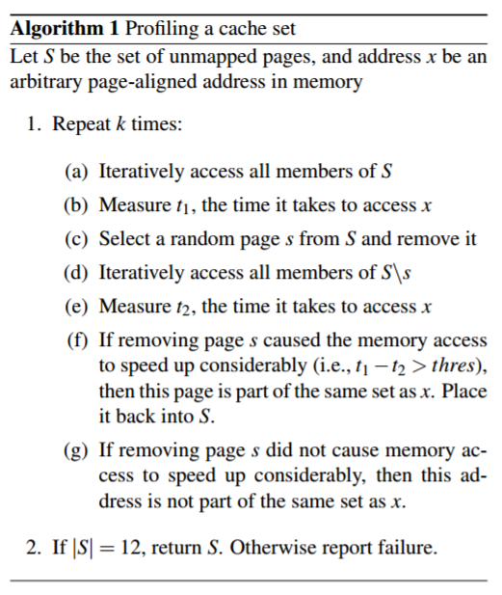
Creating an Eviction Set
This led to the greedy algorithm described in Algorithm 1.
By running Algorithm 1 multiple times, we can gradually create eviction sets covering most of the cache, except for the parts accessed by the JS runtime itself.

Slide 26
Creating an Eviction Set
We implemented Algorithm 1 in JavaScript and evaluated it on Intel machines using CPUs from the Ivy Bridge, Sandy Bridge and Haswell families, running the latest versions of Safari and Firefox on Mac OS Yosemite and Ubuntu 14.04 LTS, respectively.

Slide 27
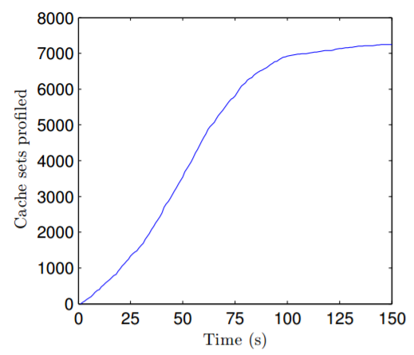
Creating an Eviction Set
The performance of the profiling algorithm, as evaluated on an Intel i7-3720QM running Firefox 35.0.1 for Mac OS 10.10.2.
Map more than 25% of the cache in under 30 seconds.
More than 50% of the
cache after 1 minute.

Slide 28
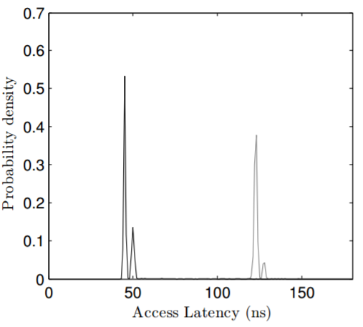
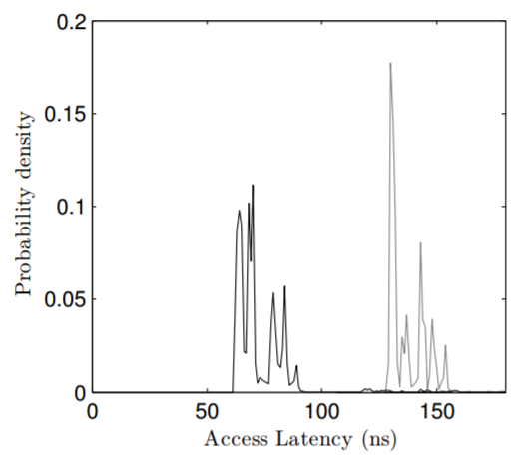
Creating an Eviction Set
To verify that our algorithm, figure shows two probability distribution functions comparing of the access latencies for a flushed (gray line) and an un- flushed (black line) variable.
(Haswell CPU)
(Sandy Bridge CPU)

Slide 29
Creating an Eviction Set
By selecting a group of cache sets and repeatedly measuring their access latencies over time, the attacker is provided with a very detailed picture of the real-time activity of the cache.
We call the visual representation of this image a “memorygram”, since it is looks quite similar to an audio spectrogram.

Slide 30
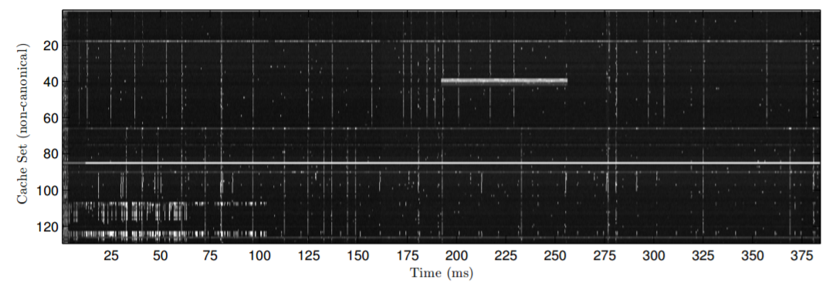
Creating an Eviction Set
A sample memorygram, collected over an idle period of 400ms, shown has a temporal resolution of 250µs and monitors total of 128 cache sets.

Slide 31
Creating an Eviction Set
The intensity of each pixel corresponds to the access latency of this particular cache set at this particular time.
Black representing a low latency, indicating no other process accessed this cache set between the previous measurement and this one.
White representing a higher latency, suggesting that the attacker’s data was evicted from the cache between this measurement and the previous one.

Slide 32
Identifying Interesting Regions in the Cache
The eviction set allows the attacker to monitor the activity of arbitrary sets of the cache, the attacker must now correlate the cache sets he has profiled to data or code locations belonging to the victim.
This learning problem was addressed earlier by Zhang et al. and by Yarom et al., where various machine learning methods such as SVM were used to derive meaning from the output of cache latency measurements.

Slide 33
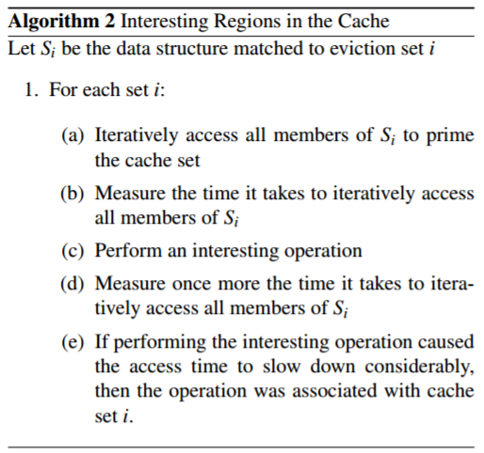
Identifying Interesting Regions in the Cache
To effectively carry out the learning step, the attacker needs to induce the victim to perform an action, then examine which cache sets were touched by this action, as formally defined in Algorithm 2.

Slide 34
Identifying Interesting Regions in the Cache
Finding a function for step (c) of the algorithm was actually quite challenging due to the limited permissions granted to JavaScript code.
The attacker needs to induce the user to perform an interesting behavior (pressing a key on his keyboard) on the behalf of the attacker. The learning process in this case might be structured or unstructured.

Slide 35
Cache-Based Covert Channel
In our particular attack model, in which the attacker is not in a co-resident virtual machine but rather inside a webpage, the motivation for a covert channel is different but still very interesting.

Slide 36
Cache-Based Covert Channel
By way of motivation, let us assume that a Security Agency is tracking the criminal mastermind Bob.
Making use of a spear phishing campaign, the Agency installs a piece of software of its own choosing, commonly referred to as an Advanced Persistent Threat (APT), on Bob’s personal computer.
The APT is designed to log incriminating information about Bob and send it to the Agency’s secret servers.

Slide 37
Cache-Based Covert Channel
Bob is however highly security savvy, and is using an operation system which enforces strict Information Flow Tracking.
This operating system feature prevents the APT from accessing the network after it accesses any file containing private user data.
Javascript-based cache attacks can immediately be put to use to allow the Agency to operate in such a scenario, as long as Bob can be enticed to view a website controlled by the Security Agency.

Slide 38
Cache-Based Covert Channel
The design of our covert channel system was influenced by two requirements:
We wanted the transmitter part to be as simple as possible, and in particular we did not want it to carry out the eviction set algorithm of Subsection 2.1.
Since the receiver’s eviction set is non-canonical, it should be as simple as possible for the receiver to search for the sets onto which the transmitter was modulating its signal.

Slide 39
Cache-Based Covert Channel
To satisfy these requirements, our transmitter (APT) simply allocates a 4K array in its own memory and continuously modulates the collected data into the pattern of memory accesses to this array. There are 64 cache sets covered by this 4K array, allowing the APT to transmit 64 bits per time period.
To make sure the memory accesses are easily located by the receiver, the same access pattern is repeated in several additional copies of the array.

Slide 40
Cache-Based Covert Channel
The receiver code profiles the system’s physical memory, then searches for one of the page frames containing the data modulated by the APT. The data can then be demodulated from the memory access pattern and uploaded back to the server, all without violating the information flow tracking protections.

Slide 41
Cache-Based Covert Channel
Our attacker model assumes that the transmitter part is written in (relatively fast) native language, while the receiver part is implemented in JavaScript.
To evaluate the bandwidth of this covert channel, we wrote a simple program that iterates over memory in a predetermined pattern (in our case, a bitmap containing the word “Usenix”).

Slide 42
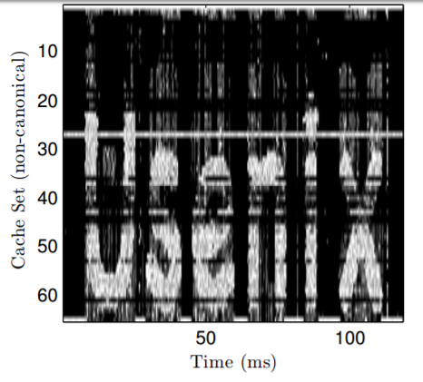
Cache-Based Covert Channel
Figure shows a memorygram capturing an execution of this covert channel. The nominal bandwidth of the covert channel was measured to be approximately 320kbps.

Slide 43
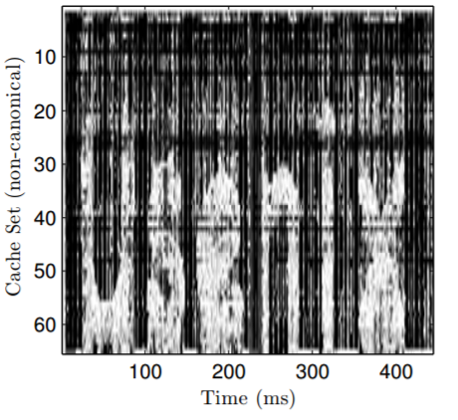
Cache-Based Covert Channel
Figure shows a similar memorygram where the receiver code is not running directly on the host, but rather on a virtual machine (Firefox 34 running on Ubuntu 14.01 inside VMWare Fusion 7.1.0).

Slide 44
Cache-Based Covert Channel
While the peak bandwidth of the in this scenario was severely degraded to approximately 8kbps, the fact that a webpage running inside a virtual machine is capable of probing the underlying hardware is still quite surprising.

Slide 45
User Behavior Tracking
This case study shows how a malicious webpage can track a user’s activity using a cache attack. In the attack presented below, we assume that the user has loaded a malicious webpage in a background tab or window, and is carrying out sensitive operations in another tab, or even in a completely different application with no Internet connectivity.

Slide 46
User Behavior Tracking
We chose to focus on mouse and network activity because the operating system code that handles them is non-negligible.
We expected them to have a relatively large cache footprint. They are also easily triggered by content running within the restricted JavaScript security model.

Slide 47
User Behavior Tracking
The structure of both attacks is similar.
First, the profiling phase is carried out
Next, during a training phase, the activity to be detected (network activity, mouse activity) is triggered, and the cache activity is sampled multiple times with a very high temporal resolution.
While the network activity was triggered directly by the measurement script (by executing a network request), we simply waved the mouse around over the webpage during the training period.

Slide 48
User Behavior Tracking
By comparing the cache activity during the idle and active periods of the training phase, the attacker learns which cache sets are uniquely active during the relevant activity and trains a classifier on these cache sets.

Slide 49
User Behavior Tracking
We calculated the Hamming weight of each measurement over time
then applied a k-means clustering of these Hamming weights to divide the measurements into several clusters.
then calculated the mean access latency of each cache set in every cluster, arriving at a centroid for each cluster.
To classify an unknown measurement vector, we measured the Euclidean distance between this vector and each of these centroids, classifying it as the closest one.

Slide 50
User Behavior Tracking
We generated network traffic using the command-line tool wget and moved the mouse outside of the browser window.
To provide ground truth:
For the network activity: we concurrently measured the traffic using tcpdump, then mapped the timestamps logged.
For the mouse activity: we wrote a webpage that timestamps and logs all mouse events. We stress that the mouse-logging webpage was run on a different browser (Chrome) than the measuring code (Firefox).

Slide 51
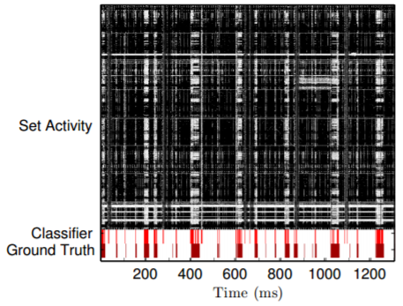
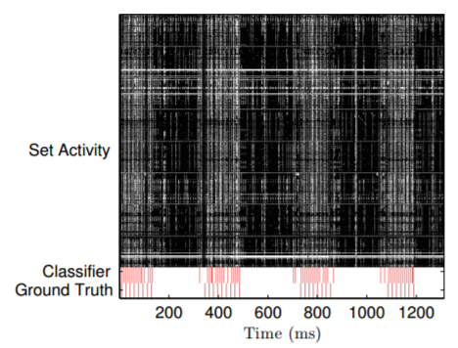
User Behavior Tracking
Network activity detection
Mouse activity detection

Slide 52
User Behavior Tracking
The techniques presented here can enable any malicious website to monitor the concurrent web activities of its users. The attack can be bolstered by more indicators, such as memory allocations, DOM layout events, disk writes and so on.

Slide 53
Conclusion
This work shows that side-channel attacks have a much wider reach than previously expected. Instead of being relevant only for very specific attacker scenarios, the attack proposed here can be mounted against most computers connected to the Internet.

Slide 54
Conclusion
Our attack requires a personal computer powered by an Intel CPU based on the Sandy Bridge, Ivy Bridge, Haswell or Broadwell micro-architectures. According to data from IDC, more than 80% of all PCs sold after 2011 satisfy this requirement.
We furthermore assume that the user is using a web browser which supports the High Resolution Time API and the Typed Arrays specification, more than 80% of desktop browsers in use today are vulnerable to the attack we describe.

Slide 55
Conclusion
Possible countermeasures to our attack:
On the micro-architectural level, changes to the way physical memory addresses are mapped to cache lines will severely confound our attack.
On the Javascript level, a possible stopgap measure would be to restrict access to this timer to applications which gain the user’s consent (for example, by displaying a confirmation window).

Slide 56
Thanks for listening

